Slide 1

CUDA: performance tuning
SM & Unified Memory Prefetching
Lara Querciagrossa, Andrew Emerson, Nitin Shukla, Luca Ferraro, Sergio Orlandini
l.querciagrossa@cineca.it
July 12th, 2022

Slide 2

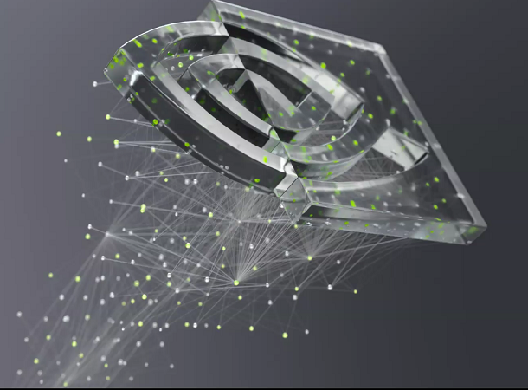
In this lecture…
Performance tuning using Streaming Multiprocessors
Unified Memory details
Asynchronous Memory Prefetching

Slide 3


Performance tuning using
Streaming Multiprocessors

Slide 4
Optimization through GPU hardware understanding
GPU hardware specific feature can promote optimization, in particular processing units called Streaming Multiprocessors (SMs).
During kernel execution, blocks of threads are given to SMs to execute.
Performance gains can often be had by choosing a grid size that has a number of blocks that is a multiple of the number of SMs on a given GPU.
SMs create, manage, schedule, and execute groupings of 32 threads from within a block called warps. Performance gains can also be had by choosing a block size that has a number of threads that is a multiple of 32.
Use a profiler (nsys profile --stats=true -f) to generate summary statistics and keep track of performance gain.
Notes:
Register = small amount of fast storage

Slide 5
nsys profiler output
nsys profile will generate a qdrep report file which can be used in a variety of manners. We use the --stats=true flag here to indicate we would like summary statistics printed. There is quite a lot of information printed:
Profile configuration details
Report file(s) generation details
CUDA API Statistics
CUDA Kernel Statistics
CUDA Memory Operation Statistics (time and size)
OS Runtime API Statistics
Notes:
Register = small amount of fast storage

Slide 6

SMs and warps
GPU with 16 SMs
Notes:
Register = small amount of fast storage

Slide 7
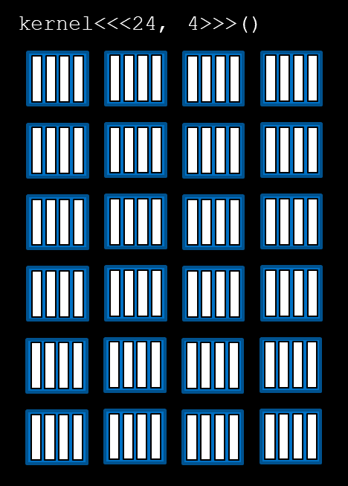
SMs and warps
GPU with 16 SMs
Notes:
Register = small amount of fast storage

Slide 8
SMs and warps
GPU with 16 SMs
Notes:
Register = small amount of fast storage

Slide 9
SMs and warps
Grid dimensions divisible by the number of SMs on a GPU can promote full SM utilization
GPU with 16 SMs
Unused SMs
Notes:
Register = small amount of fast storage

Slide 10
Programmatically querying GPU device properties
The number of SMs on a GPU can differ depending on the specific GPU being used, so the number of SMs should not be hard-coded into a code bases.
This information should be acquired programatically.
To obtain the id of the currently active GPU:
int deviceId;
cudaGetDevice(&deviceId);
To obtain a C struct which contains many properties about the currently active GPU device, including its number of SMs:
cudaDeviceProp props;
cudaGetDeviceProperties(&props, deviceId);
Notes:
Register = small amount of fast storage

Slide 11
Exercise: 14_query_device.cu
This code contains many unassigned variables: it will print gibberish information intended to describe details about the currently active GPU.
Modify the to print the actual values for the desired device properties indicated in the source code.
In order to support your work, and as an introduction to them, use the CUDA Runtime Docs (https://docs.nvidia.com/cuda/cuda-runtime-api/structcudaDeviceProp.html) to help identify the relevant properties in the device props struct.
Notes:
Register = small amount of fast storage

Slide 12
Exercise: 15_vector_add_sm.cu
Refactor the addVectorsInto kernel you have been working on in previous exercise so that it launches with a grid containing a number of blocks that is a multiple of the number of SMs on the device.
Depending on other specific details in the code you have written, this refactor may or may not improve, or significantly change, the performance of your kernel. In the next day, you may want to use nsys profiler to quantitatively evaluate performance changes.
Notes:
Register = small amount of fast storage

Slide 13
Unified Memory details

Slide 14
Unified Memory details
Unified Memory (UM) allows automatic memory migration and makes programming easier.
How does cudaMallocManaged actually works?
Notes:
Register = small amount of fast storage

Slide 15
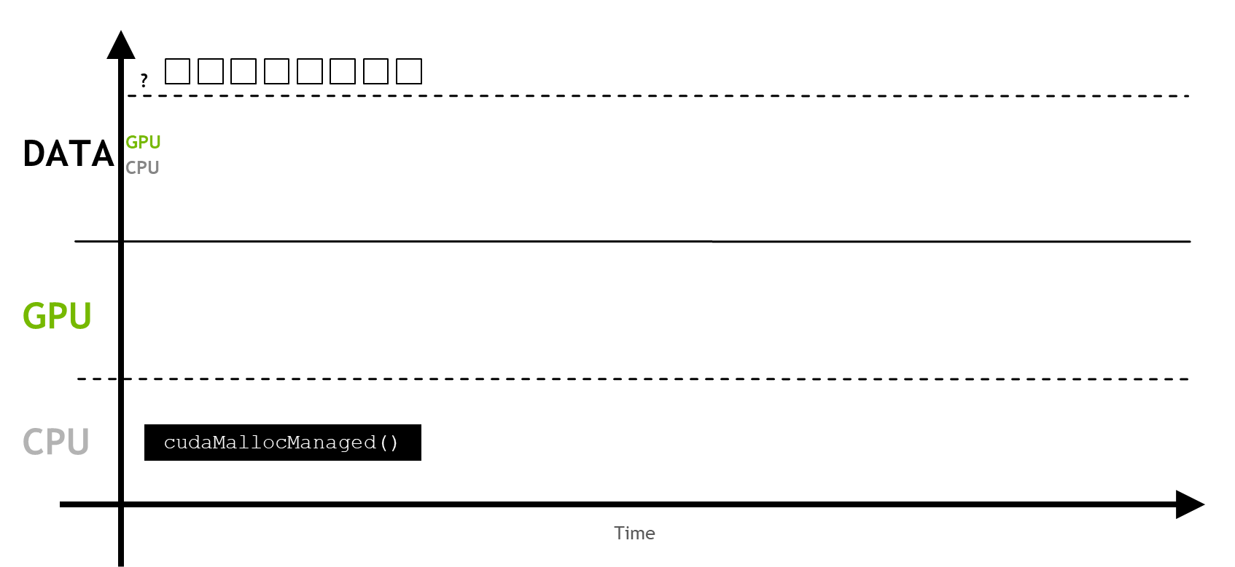
Unified Memory details
When UM is allocated, the memory is not resident yet on either the host or the device.
Notes:
Register = small amount of fast storage

Slide 16
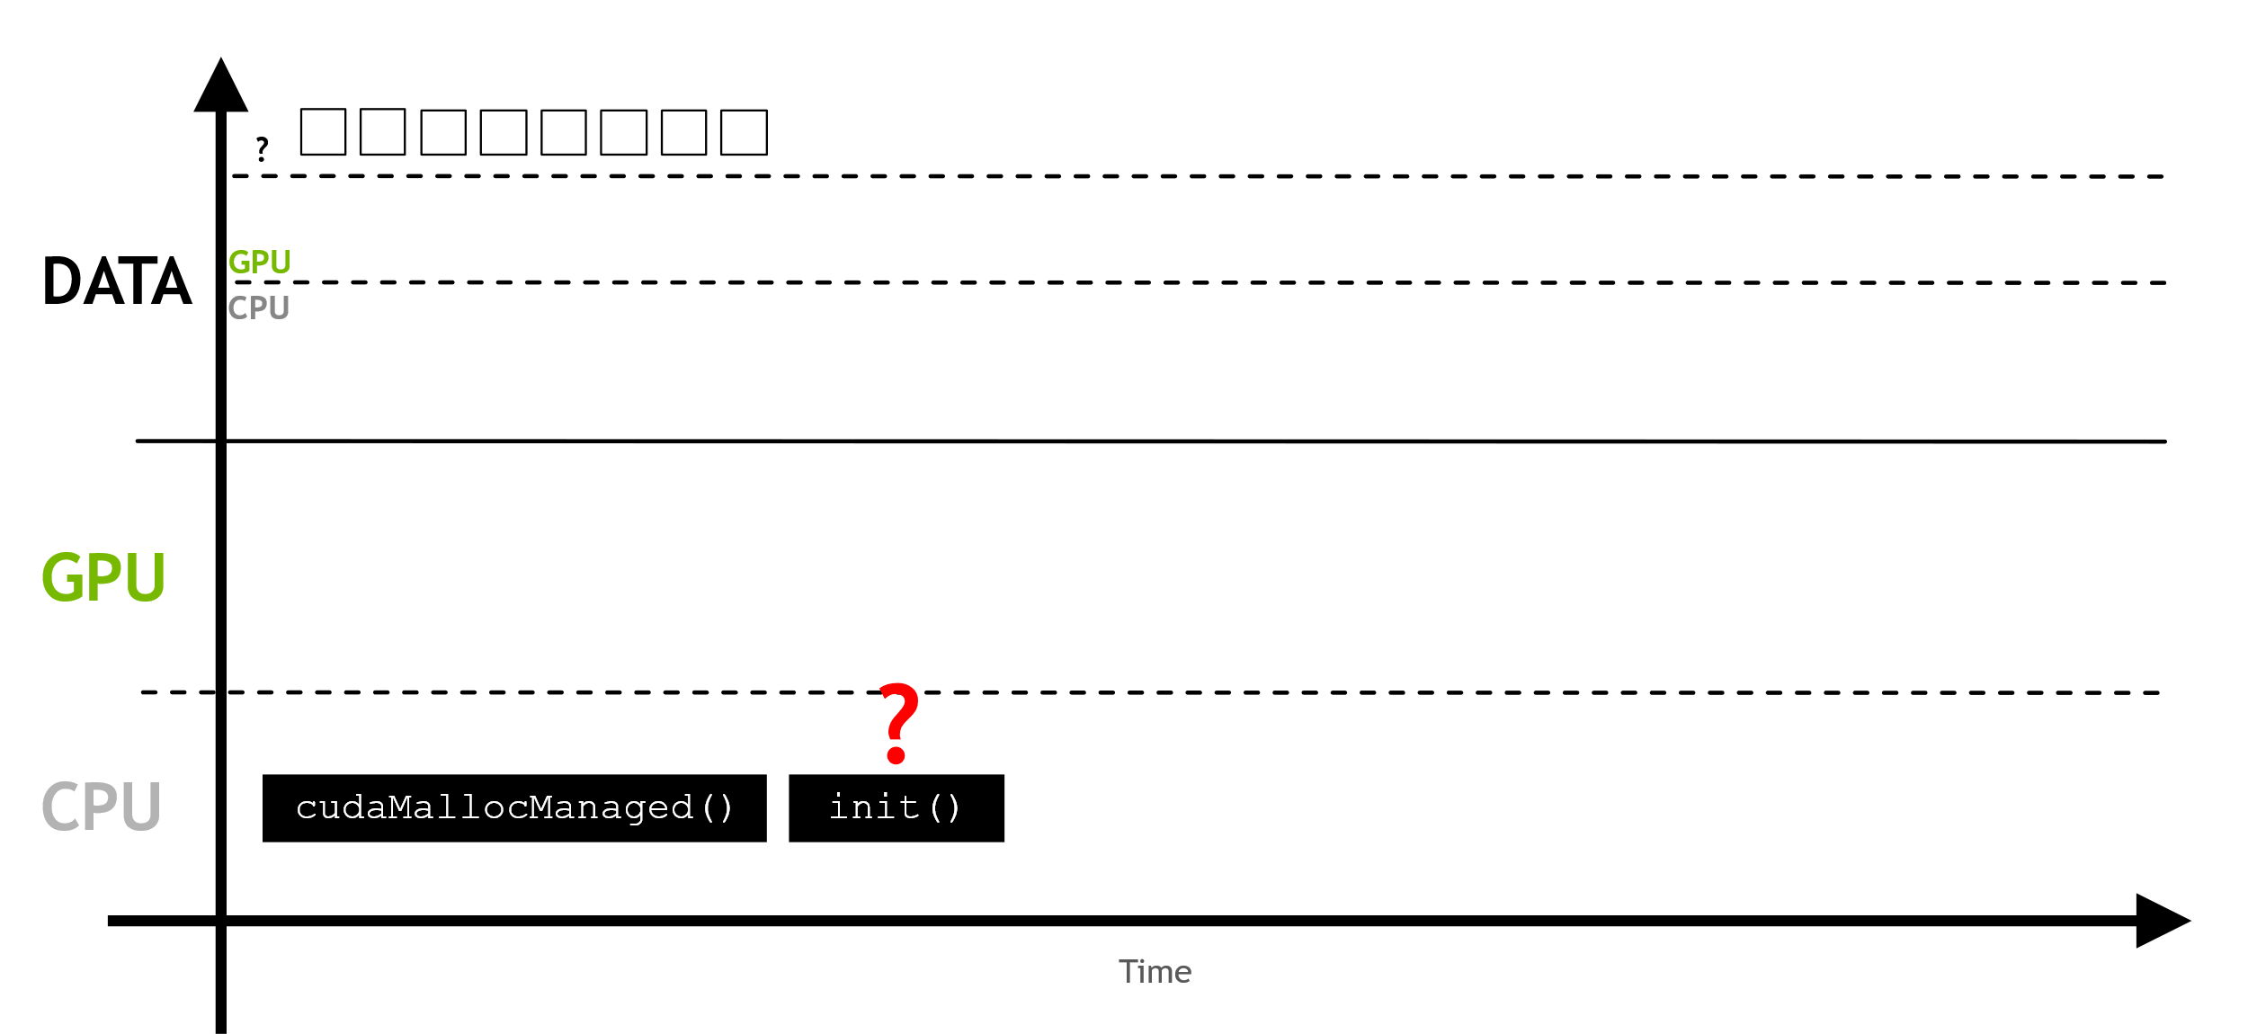
Unified Memory details
When the host or the device attempts to access the memory, a page fault will occur.
Notes:
Register = small amount of fast storage

Slide 17
Focus: what is a page fault?
Notes:
Register = small amount of fast storage

Slide 18
But first: what is a page?
A page, memory page, or virtual page, is a fixed-length contiguous block of virtual memory, described by a single entry in the page table.
Notes:
Register = small amount of fast storage

Slide 19
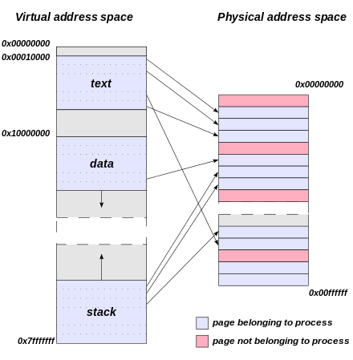
But first: what is a page?
A page, memory page, or virtual page, is a fixed-length contiguous block of virtual memory, described by a single entry in the page table.
The page table is a data structure used by a virtual memory system to store the mapping between virtual addresses and physical addresses.
software
hardware: RAM

Slide 20
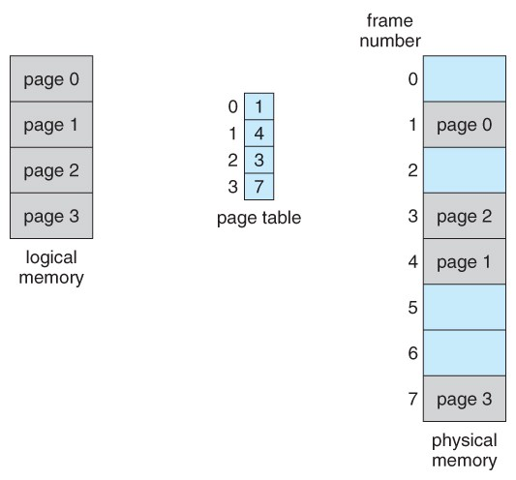
But first: what is a page?
A page, memory page, or virtual page, is a fixed-length contiguous block of virtual memory, described by a single entry in the page table.
The page table is a data structure used by a virtual memory system to store the mapping between virtual addresses and physical addresses.
It is necessary to the mapping needed to access data in memory.

Slide 21
But first: what is a page?
A page, memory page, or virtual page, is a fixed-length contiguous block of virtual memory, described by a single entry in the page table.
It is the smallest unit of data for memory management in a virtual memory operating system.
Similarly, a page frame is the smallest fixed-length contiguous block of physical memory into which memory pages are mapped by the operating system.
A transfer of pages between main memory and an auxiliary store, such as a hard disk drive, is referred to as paging or swapping.
Notes:
Register = small amount of fast storage

Slide 22
Focus: what is a page fault?
A page fault is an exception that the memory management unit (MMU) raises when a process accesses a memory page without proper preparations (no valip mapping from virtual to physical address space or page content not in the RAM).
This exception force the operating system to find the block in virtual memory and made it accessible.
Sometimes an invalid page fault can occur (for example when the system tries to access a memory address that does not exist).
Most page faults are usually valid: these are common and necessary to increase the amount of memory available to programs in any operating system that utilizes virtual memory.
Notes:
Register = small amount of fast storage

Slide 23
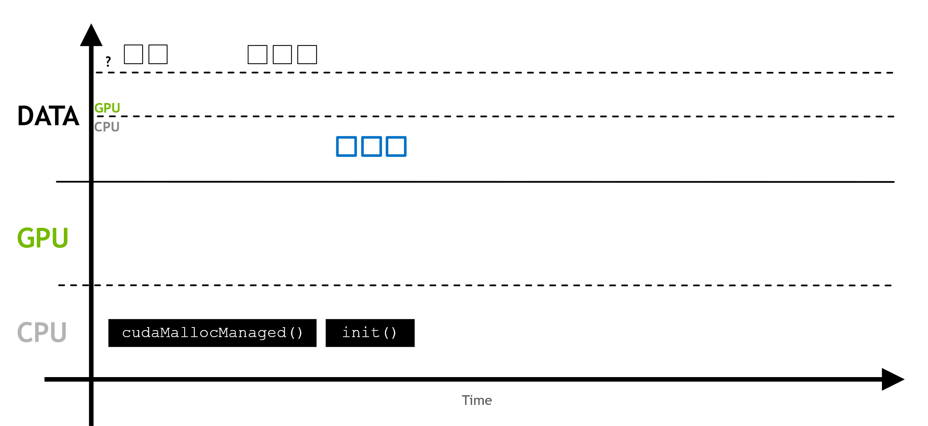
Unified Memory details
This page fault triggers the migration of the required memory.
Notes:
Register = small amount of fast storage

Slide 24
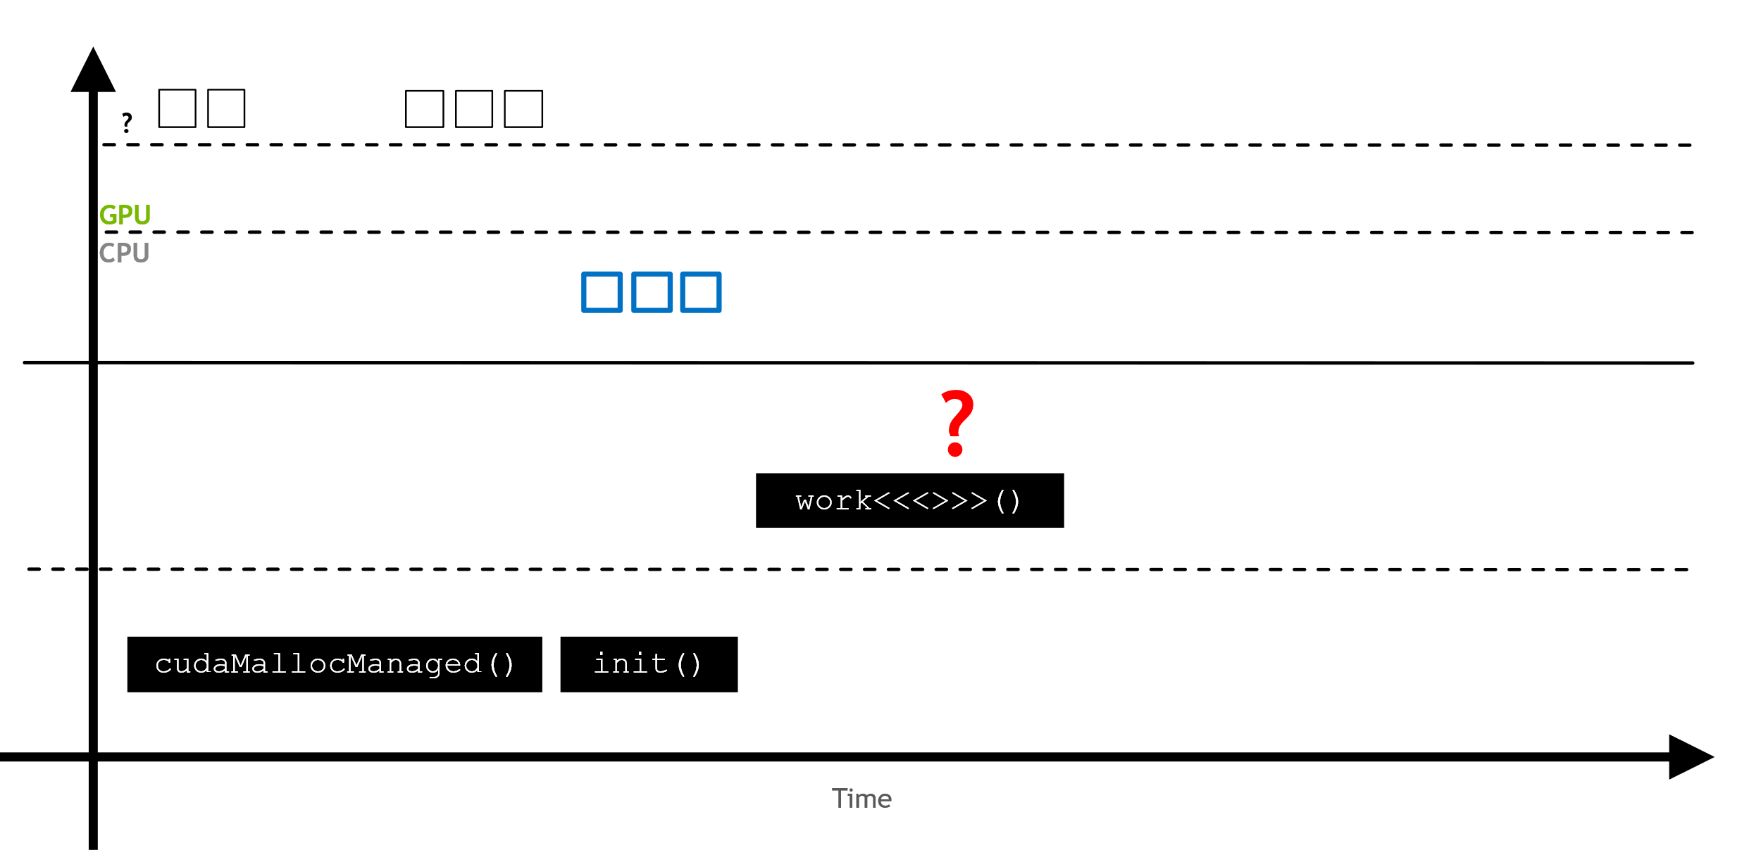
Unified Memory details
This process repeats every time the memory is requested somewhere in the system where it is not resident.
Notes:
Register = small amount of fast storage

Slide 25
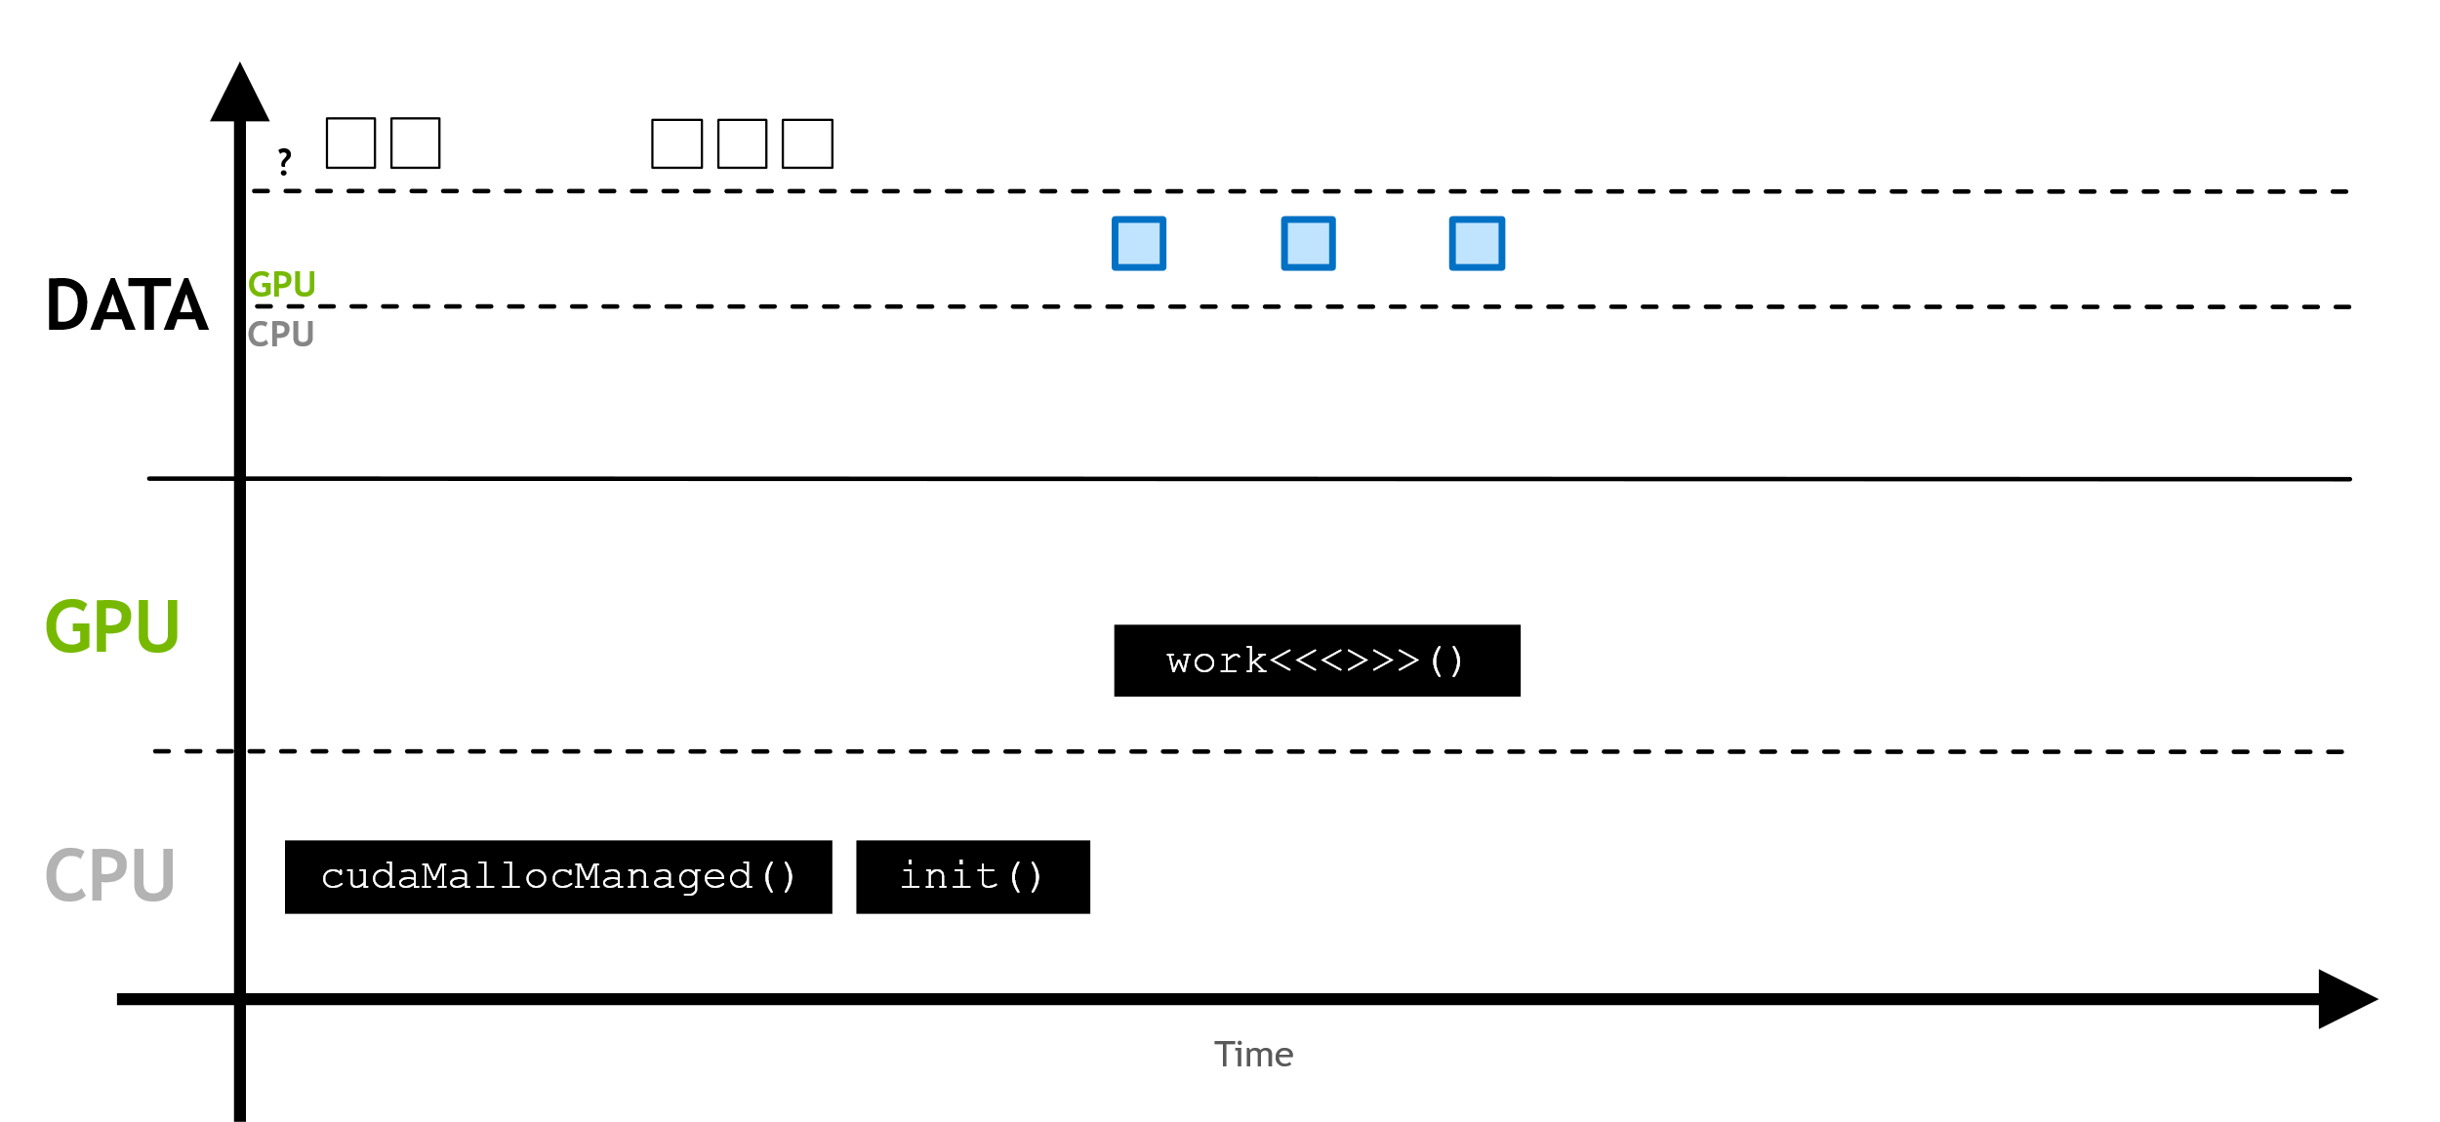
Unified Memory details
Here the page fault triggers the migration of the requested memory to the GPU.
Notes:
Register = small amount of fast storage

Slide 26
Unified Memory: prefetching
Using UM automatic memory migration is useful especially when:
working with data that exhibits sparse access patterns, for example when it is impossible to know which data will be required to be worked on until the application actually runs,
when data might be accessed by multiple GPU devices in systems with multiple GPUs.
On the other hand, there are some cases the overhead of page faulting and on demand data migration are quite high and would be better avoided:
when data needs are known prior to runtime,
when large contiguous blocks of memory are required.
Notes:
Register = small amount of fast storage

Slide 27
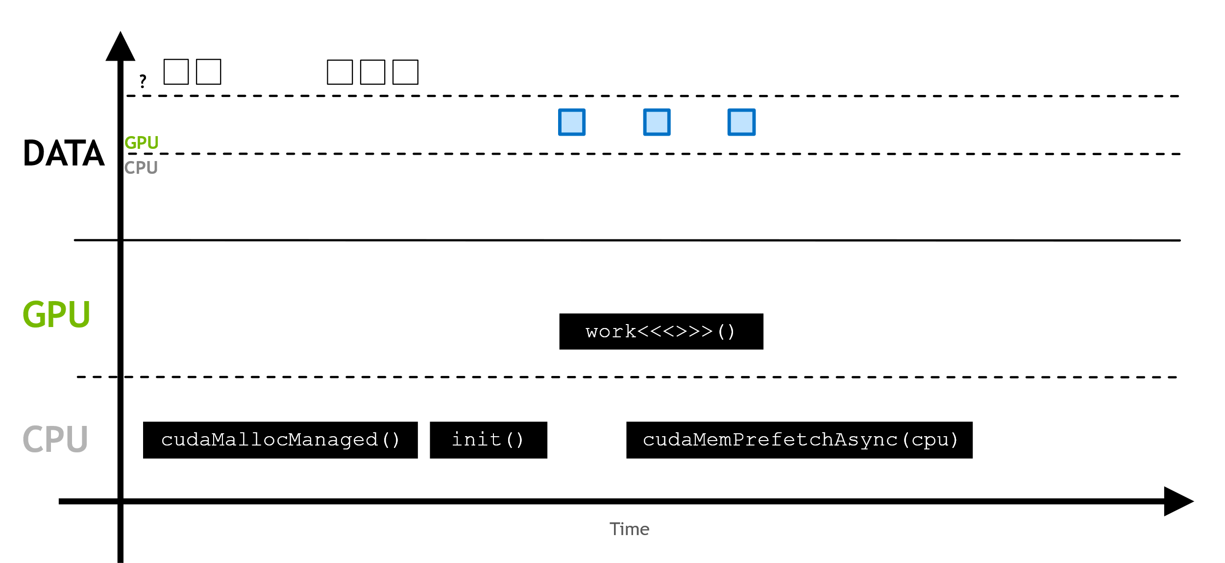
Unified Memory: prefetching
If it is known that the memory will be accessed somewhere it is not resident, asynchronous prefetching can be used.
Notes:
Register = small amount of fast storage

Slide 28
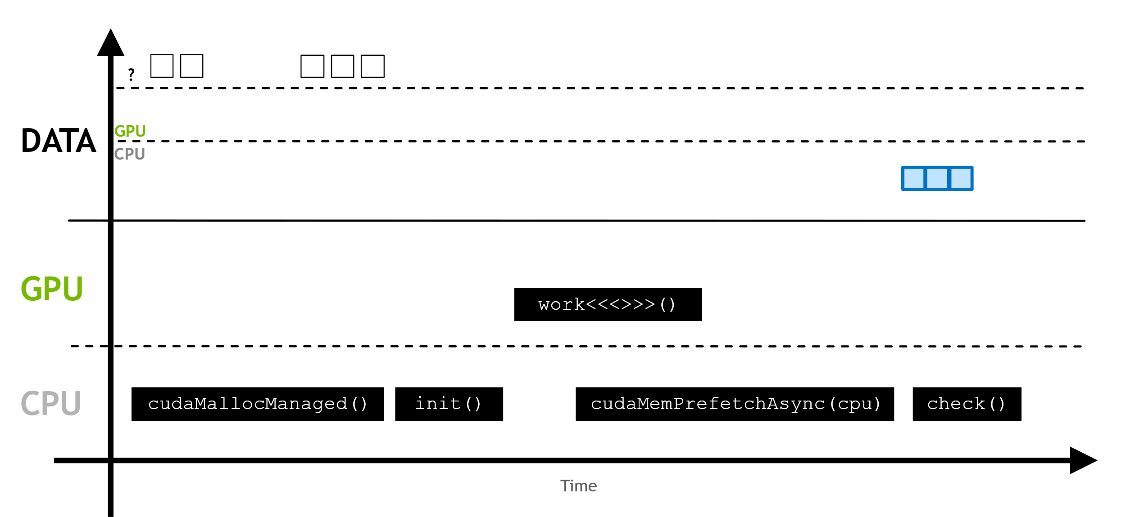
Unified Memory: prefetching
This moves the memory in larger batches, and prevents page faulting.
Notes:
Register = small amount of fast storage

Slide 29
Unified Memory: prefetching
This moves the memory in larger batches, and prevents page faulting.
Notes:
Register = small amount of fast storage

Slide 30
Exercise: 16_page_faults
In this exercise we will explore how UM data migration behaves under the hood.
The code contains two functions that fills a vector (of 33 million elements). One, hostFunction, does the work in the CPU, while deviceKernel works on the GPU. Currently, no function call is done.
Let’s see what happen in different scenarios. We will use text output of nsys profile --stats=true. Answer these three questions for each scenario.
Is there a CUDA Memory Operation Statistics section in the output?
If yes, does it indicate host to device (HtoD) or device to host (DtoH) migrations?
If there are migrations, how many Operations there were? (many operations = on-demand page faulting)
Notes:
Register = small amount of fast storage

Slide 31
Exercise: 16_page_faults
The scenarios to analyze are the following
Only hostFunction is called.
Only deviceKernel is called.
Access UM first from the host and then from the GPU.
Access UM first from the device and then from the CPU.
Notes:
Register = small amount of fast storage

Slide 32
Exercise: 16_page_faults
The scenarios to analyze are the following
Only hostFunction is called.
No CUDA Memory Operation Statistics section.
Only deviceKernel is called.
No CUDA Memory Operation Statistics section.
Access UM first from the host and then from the GPU.
598 HtoD operations.
Access UM first from the device and then from the CPU.
640 DtoH operations.
Notes:
Register = small amount of fast storage

Slide 33
Exercise: 17_init_vector_kernel
In this exercise you will refactor the routine that initializes vectors to be added to be a CUDA parallel kernel, instead of CPU function.
Profile your solution with nsys profile --stats=true.
Try to answer the following question before collection data from the profiler.
How will the UM memory migration behavior change?
2. Will the runtime of addVectorsInto change?
Notes:
Register = small amount of fast storage

Slide 34
Asynchronous Memory
Prefetching

Slide 35
Asynchronous Memory Prefetching: sum up
Asynchronous memory prefetching allows to asynchronously migrate unified memory to any CPU or GPU device in the system, explicitly, but in the background, before they are needed by application code itself.
Increase of GPU kernels and CPU function performance thanks to reduced page fault and on-demand data migration overhead.
Data tends to be migrated in larger chunks, so fewer trips are needed
Can be used when data access needs are known before runtime, and when data access patterns are not sparse.
Notes:
Register = small amount of fast storage

Slide 36
Asynchronous Memory Prefetching: how to
CUDA uses cudaMemPrefetchAsync function to asynchronously prefetching managed memory to either a GPU device or the CPU easily.
int deviceId;
cudaGetDevice(&deviceId);
cudaMemPrefetchAsync(pointerToSomeUMData, size, deviceId);
cudaMemPrefetchAsync(pointerToSomeUMData, size, cudaCpuDeviceId);
prefetch to GPU
prefetch to host
built-in variable
Notes:
Register = small amount of fast storage

Slide 37
Exercise: 18_vector_add_prefetch.cu
Now, our vector add application initializes vectors and sum 2 of them with CUDA kernels.
To further understand memory migration and page-faulting, try these three scenarios. Make hypotheses on UM behavior/page-faulting and initialization kernel runtime.
What happens when you prefetch one of the initialized vectors to the device?
What happens when you prefetch two of the initialized vectors to the device?
What happens when you prefetch all three of the initialized vectors to the device?
What happens when you prefetch all three initialized vectors to the device and prefetch also back to the CPU before correctness check?
Notes:
fewer, but larger, memory transfers, and kernel execution time is significantly decreased

Slide 38
Exercise: 18_vector_add_prefetch.cu
Now, our vector add application initializes vectors and sum 2 of them with CUDA kernels.
To further understand memory migration and page-faulting, try these three scenarios. Make hypotheses on UM behavior/page-faulting and initialization kernel runtime.
What happens when you prefetch one of the initialized vectors to the device?
What happens when you prefetch two of the initialized vectors to the device?
What happens when you prefetch all three of the initialized vectors to the device?
What happens when you prefetch all three initialized vectors to the device and prefetch also back to the CPU before correctness check?
Results: fewer larger memory transfers & decreased kernel execution time
Notes:
fewer, but larger, memory transfers, and kernel execution time is significantly decreased

Slide 39
References

Slide 40

References
Previous editions of this school at CINECA
Oakridge National Laboratory’s “Introduction to CUDA C++”: https://www.olcf.ornl.gov/calendar/introduction-to-cuda-c/
NVIDIA DL Institute Online Course: main source of exercises
www.computerhope.com/jargon/p/pagefaul.htm
blogs.nvidia.com
Wikipedia

Slide 41
THANK YOU!
Lara Querciagrossa
l.querciagrossa@cineca.it

